Slide 1


💻 Laptop Price Prediction using Machine Learning
This project provides a robust machine learning solution for predicting laptop prices. By leveraging a Random Forest Regressor and comprehensive data preprocessing, the model offers accurate price estimations based on key specifications such as RAM, GPU, screen resolution, processor type, and weight. This document outlines the project's features, installation steps, model pipeline, and optional visualization and web application integrations, providing a complete guide for data scientists and machine learning engineers.
by Shivaprasad Samera

Slide 2
🚀 Key Features and Capabilities
The Laptop Price Prediction project is designed with a set of powerful features to ensure accurate and insightful predictions. It starts with robust data handling, capable of cleaning and formatting diverse datasets. The core of the project lies in its machine learning model, which utilizes a Random Forest Regressor for precise price predictions.
Data Preprocessing: Handles missing values, cleans raw data, and formats the dataset appropriately for model consumption.
Machine Learning Model: Implements a Random Forest Regressor for highly accurate laptop price predictions.
Visualization & Analysis: Uses popular libraries like Matplotlib and Seaborn to generate insightful charts and graphs, helping to understand data distributions and model performance.
Power BI Dashboard (Optional): Provides an interactive dashboard for visualizing trends and analyzing laptop pricing dynamics.
Web Application (Optional): A Streamlit-based user interface allows for easy, on-demand price predictions through a simple web form.

Slide 3
📂 Dataset Overview
The foundation of this price prediction model is a comprehensive dataset containing detailed specifications for over 1300 laptops. This rich dataset allows for thorough analysis and robust model training, capturing various factors that influence laptop pricing.
Each entry in the dataset includes crucial attributes:
Company: Manufacturer of the laptop (e.g., Apple, Dell, HP, Lenovo).
Type Name: Category of the laptop (e.g., Ultrabook, Notebook, Gaming).
RAM: Random Access Memory in GB.
GPU: Graphics Processing Unit details.
Screen Resolution: Display resolution (e.g., 1920x1080).
CPU: Central Processing Unit specifications.
Weight: Laptop weight in kilograms.
Operating System: Installed OS (e.g., Windows, macOS, Linux).
Price: The target variable, representing the laptop's price.
This diverse set of features ensures that the model can learn complex relationships and provide accurate predictions across a wide range of laptop configurations.

Slide 4

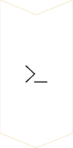

🔧 Installation and Setup
To get started with the Laptop Price Prediction project, follow these simple steps to clone the repository and install all necessary dependencies. Ensure you have Python and pip installed on your system before proceeding.
Step 1: Clone the Repository
git clone https://github.com/your-username/Laptop-Price-Prediction.git
Navigate into the cloned directory:
cd Laptop-Price-Prediction
Step 2: Install Dependencies
All required libraries are listed in requirements.txt. Install them using pip:
pip install -r requirements.txt
Step 3: Run the Model
Execute the main Python script to run the prediction model:
python laptop_price_prediction.py
These steps will set up your environment and run the core prediction script, allowing you to quickly verify the project's functionality.

Slide 5
🛠 Model Training Pipeline
The project employs a meticulously structured machine learning pipeline to ensure robust and accurate price predictions. Each stage is designed to optimize data flow and model performance.
1. Data Cleaning & Preprocessing
This initial stage involves handling missing values, standardizing formats, and correcting inconsistencies in the raw dataset to prepare it for analysis.
2. Feature Engineering
New features are derived from existing ones (e.g., processing text-based GPU or CPU descriptions into numerical representations, extracting specific values from RAM or screen resolution strings) to enhance the model's predictive power.
3. Data Splitting (Train-Test Split)
The processed dataset is divided into training and testing sets, typically an 80/20 split, to allow for independent evaluation of the model's generalization capabilities.
4. Model Training (Random Forest Regressor)
A Random Forest Regressor is trained on the prepared training data. This ensemble learning method is chosen for its robustness and ability to handle complex, non-linear relationships in the data.
5. Model Evaluation
The trained model's performance is assessed using key regression metrics such as the R² Score, which indicates the proportion of variance in the dependent variable predictable from the independent variables, and Mean Squared Error (MSE), which measures the average squared difference between estimated values and actual value.
6. Visualization
Post-evaluation, visualizations are generated to illustrate insights like feature importance (which features most influence price) and prediction accuracy (actual vs. predicted prices).

Slide 6
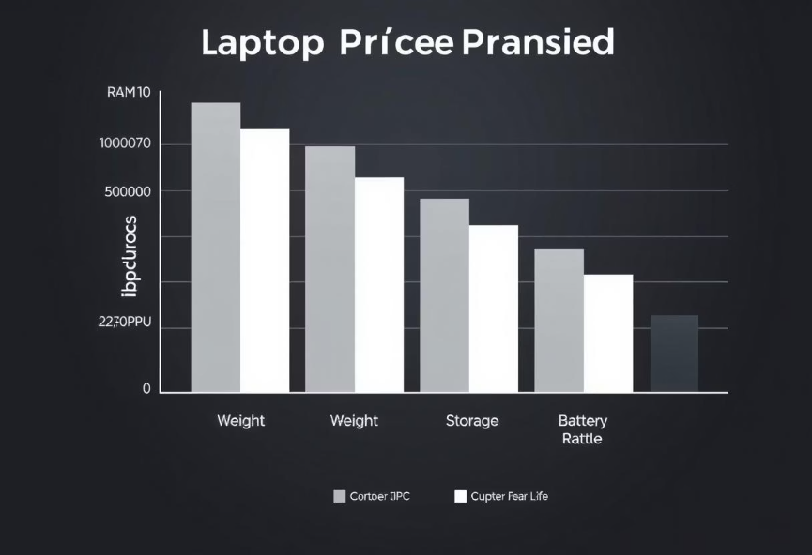
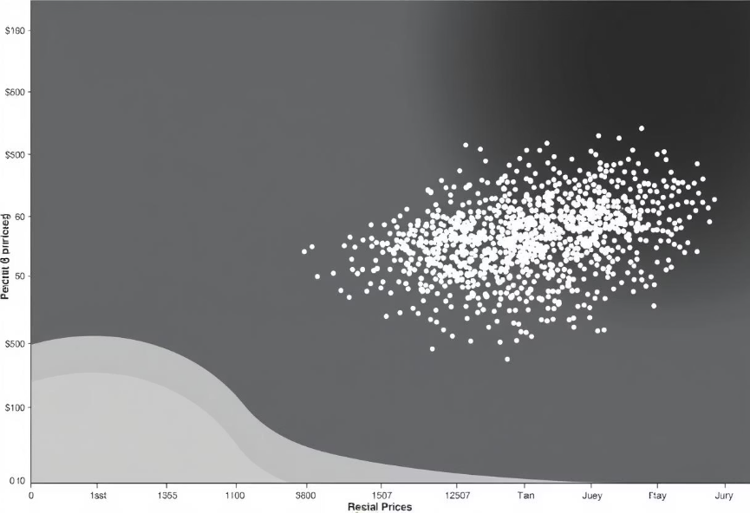
📊 Visualization & Insights
Understanding the factors influencing laptop prices and the model's performance is crucial. This project leverages Matplotlib and Seaborn to provide clear visualizations that offer deep insights.
Feature Importance (Impact on Price)
Error Analysis (Actual vs. Predicted Prices)
This bar chart illustrates which features have the most significant impact on laptop price predictions. Features like RAM and GPU often appear at the top, indicating their strong correlation with price.
The scatter plot compares the actual laptop prices against the prices predicted by the model. A good model will show points closely clustered around the diagonal line, indicating high accuracy.
import matplotlib.pyplot as plt
import seaborn as sns
# Extract feature importance from model
importances = model_pipeline.named_steps["randomforestregressor"].feature_importances_
feature_names = X_train.columns
plt.figure(figsize=(10, 6))
sns.barplot(x=importances, y=feature_names)
plt.xlabel("Importance Score")
plt.ylabel("Feature")
plt.title("Feature Importance in Laptop Price Prediction")
plt.show()
plt.figure(figsize=(8, 6))
sns.scatterplot(x=y_test, y=y_pred)
plt.xlabel("Actual Price")
plt.ylabel("Predicted Price")
plt.title("Actual vs. Predicted Laptop Prices")
plt.show()

Slide 7
📊 Power BI Dashboard Integration (Optional)
For interactive exploration and business intelligence, the project can be integrated with Power BI. This allows stakeholders to dynamically analyze pricing trends and model predictions without needing to interact with the code directly.
Follow these steps to create an interactive Power BI dashboard:
results.to_csv("laptop_price_predictions.csv", index=False)
Export Predictions as CSV: After running the model, export the actual and predicted prices, along with relevant features, into a CSV file. This provides a portable dataset for Power BI.
Import into Power BI: Open Power BI Desktop, import the laptop_price_predictions.csv file, and load the data into the Power BI data model.
Create Scatter Plot: Design a scatter plot with 'Actual Price' on one axis and 'Predicted Price' on the other. This visualizes model accuracy, similar to the Python plot but with Power BI's interactive capabilities.
Add Insights & Filters: Enhance the dashboard by adding filters for company, RAM, GPU, or any other feature. Incorporate other visualizations like bar charts for average prices by brand or line charts for price trends over time (if time data is available). This allows for deep-dive analysis and quick insights.

Slide 8
🖥 Web Application (Optional)
A user-friendly web application built with Streamlit offers a simple interface for on-demand laptop price predictions. This allows non-technical users to easily interact with the trained model.
The Streamlit application provides interactive input fields for laptop specifications. Users can select values for company, RAM, and weight, and instantly receive an estimated price.
import streamlit as st
import pandas as pd
import joblib
# Load trained model
model = joblib.load("laptop_price_model.pkl")
st.title("Laptop Price Prediction")
st.write("Enter laptop specifications to estimate the price.")
# User inputs
company = st.selectbox("Company", ["Apple", "HP", "Dell", "Lenovo"])
ram = st.slider("RAM (GB)", 4, 64, 8)
weight = st.slider("Weight (kg)", 1.0, 5.0, 2.0)
# Prediction
input_data = pd.DataFrame([[company, ram, weight]], columns=["Company", "Ram", "Weight"])
predicted_price = model.predict(input_data)[0]
st.write(f"Estimated Price: **₹{predicted_price:.2f}**")
To run the web application:
streamlit run app.py
This will launch the application in your web browser, providing a convenient way to demonstrate and utilize the price prediction model.

